Slide 1
Science in eCommerce: From Interviews to Success
INFORMS Connect, July 20, 2023
Nirmit Chetwani, Manager – Science @ Amazon
Notes:
HI, my name is Nirmit, and I am a science manager at Amazon. Today, I am going to talk about Science in eCommerce – where I will cover how to get into science roles in eCommerce and then how to succeed in those roles! Let’s formally cover the Agenda for today’s webinar.

Slide 2
Agenda

Slide 3
About Me
Knowing your WHAT & WHY – Startups vs Big-Tech, Optimization vs ML, Industry, etc.
Science in eCommerce
Applications
Tips to Get In
Tips to Succeed in Science Role
Questions
Notes:
First, I will give a brief introduction about myself; then I will talk about the importance of knowing “WHAT” you want to do in your career and “WHY” you want to do that? On that I will cover angles such as whether you would want to work for startups or big tech companies, eCommerce or entertainment, etc.
Then we’ll jump into Science in eCommerce, where we’ll cover an overview of science applications in eCommerce in general, some tips to get into eCommerce science jobs/positions, and finally, once you get in, what are some of the things (from soft skills) standpoint that I feel distinguishes an average scientist from an exceptional one!
Finally, I’ll open the floor to any questions!
Let’s get right into it!

Slide 4
About Me
Career Journey, Life Outside of Work

Slide 5
Career Journey
First Love: Math, Science
Undergrad in Math @ IIT Kharagpur
Science in India-based Startups, 3 years
MS in DS @ Georgia Tech
Science @ Amazon
Notes:
So talking a little bit about my background:
I did my undergrad in Mathematics and Computer Science @ Indian Ins. Of Tech, Kharagpur, from where I graduated in 2014. Then, I worked in eCommerce start-ups (in food-tech and fashion-tech) back in India for three years, where I led their analytics/science teams. While I was working in those startups, I gained a lot of breadth of expertise across analytics domain, and I wanted to sharpen/hone my analytical depth skills – to which, I came for my masters at Georgia Tech. I did a dual major at tech – Computational Data Science and Statistical Modeling. When I was at tech, Amazon hosted a data science competition there, which I won – that served as an entry door for me at Amazon, where I started working as a data scientist in early 2019. In the last 4.5 years at Amazon, I have worked across developing science for last-mile deliveries performed by Amazon, to leading a science team of 9 now currently that develops science solutions for FC labor planning and damage reductions.

Slide 6
Life Outside Work
Second Love: Outdoors
Sawtooth @ Idaho
Mt. Baker @ PNW
Photography and Climbing
Notes:
Outside of work, I love being outdoors: particularly, I enjoy taking photos and climbing mountains!

Slide 7
Knowing your WHAT & WHY
Critical for Long-term Career Growth
Notes:
Now going into knowing your what and why?

Slide 8
Figuring the “WHAT”
Limited Time;
Future Career Growth
Product or Science or Strategy?
ML, Optimization, Statistics or Analytics?
Small company or Big?
Industry: eCommerce, Entertainment, Sports?
Notes:
First, I want to talk about your WHAT? It is really important to figure out your WHAT, since we all know the time is of essence when you’re prepping for science/analytics based interviews. Not knowing what you want would lead you to spend a lot of time learning up concepts/topics that are potentially not the best match with what you’re looking for! Second, defining your know is not only for today, it’ll also help in your future career growth! Needless to say, your WHAT might evolve with time, but you should always be making a conscious choice about it!
First dimension that I think is critical to look answers for is: do you want to work on product development? or science? Or strategy? Or data engineering? Knowing what the expectations of these roles are would be helpful!
Second: If you’re interested in working on science – any particular domain within science that interests you? Important to find since science in general is so diverse!
Third: Do you want to work at a small company or a big company? Both have their pros and cons! Working in a startup for me was very rewarding – I learnt how to act fast and deliver things very fast, in bigger companies, there’s generally a lot of dependency on anything you try to do, so you slow down a bit. In startups, you get a breadth of knowledge, like for me, I did finance analytics, marketing science, operations optimization, product analytics -- all the things, but I barely scratched the surface for everything. In bigger companies, you generally do depth first rather than breadth first, like at Amazon, I have developed a lot of expertise in applications of ML and optimization in Supply Chain. Startups come with their own risk and are generally less stable, whereas bigger companies, in general, are more stable/secure. Lastly, if you’re particularly interested in any industry – I’d say you should go for it! Like for me, I love eCommerce as an industry, which I will tell why later.

Slide 9
Figuring the “WHY”
Deep interest >> Short term Benefits
Love the Discipline through academics/exp
Future Career Growth Prospects
Offers Higher Compensation
Experiment Phase: Trying before Committing
Notes:
Second, knowing the “why” for your “what” is as important since if you’re clear with your why, it’s coming out of a choice (in most situation) and those generally stick around in long-term.
First dimension is: would you like to do something in your career because you just love the discipline through academics and/or experience? For example, some people just enjoy doing the problem solving component that science offers!
Second – is the particular field going to offer you really strong growth prospects because the industry itself is booming? For example, LLMs right now is a hot topic, and a lot of experts say it is going to be the next big thing!
Third: No I just like this field, or company, or industry because it pays the most haha.
Lastly, no I don’t know why, but I am going to try and find answers through experimenting.

Slide 10
My “WHAT” & “WHY”
Science, Fast-paced Dev, eCommerce
Science: Love for Math, CS and its application to business
At the intersection of ML and Optimization
Company with a fast-paced development environment and experiment mentality
eCommerce due to wide-range of science applications
Notes:
Just to summarize, for my WHAT and WHY:
I love to work at the intersection of ML and Optimization because I absolutely loved my undergrad coursework in math and computer science, and found really interesting to apply those concepts in industry problems – this I learnt through my internships. I love working at the intersection of ML and optimization because they both of them combined generally form end-to-end science framework of any problem.
I always loved working at a fact paced environment: because I love to see results and materialization of my work, it gives me joy!
Lastly, I absolutely love working in the eCommerce industry because there are just so many problems to solve with the help of science – across advertising, supply chain, product, logistics – just so many, great for future career prospects as a scientist. When I was interviewing post my graduate studies in the US, I always used to ask myself of the problems I’d love to solve for a company, and if I could only come up with a small number of problems to solve, that was a big RED flag for me to interview for a company.
This is a good Segway into my next topic, which is applications of science in eCommerce.

Slide 11
Science in eCommerce
Applications and How to Nail

Slide 12
Applications across Domains
So many problems to solve
Advertising: Statistics/Experimentation, ML and Optimization
Operations: ML, Optimization, Simulation
Product: Statistics/Experimentation, Optimization, ML
Notes:
The thing that excites me most about science in eCommerce is that there are just so many problems to solve! When I was leading science and analytics for one of the startups in India, I broadly categorized my team into three broad verticals:
Advertising/Marketing science: problems like predicting user churn, finding the best retention policies for them who’re likely to churn, measuring the effectiveness of offers, attribution modeling, etc are just high level examples. In my opinion, advertising has the widest applications of experimentation/statistics, then ML and finally optimization. The biggest optimization application is probably finding the appropriate bidding amount for an ad that you’d want to host on your site.
Second certical, Operations Science: Stuff like delivery routing, call-center/associate hiring based on order forecasting, finding where to set a delivery hub or a warehouse, etc would be typical problems to solve in this area! In my opinion, we have a lot of ML and optimization applications in this domain, but there are a lot of things that require one time investments in this space, for which experiments are hard to perform. Like, you can’t buy a building as a warehouse as an experiment! Hence, robust simulation also becomes super critical in this domain.
Third, Product Science: Problems like product listing order, recommendations, measuring user journey, etc would fall under this umbrella. Again, for eCommerce, statistics/experimentation is super critical in this domain because that serves as an affirmative tool for you to help your product evolve fast. Then, optimization and ML also have a good number of applications, recommendation engine is a conjunction of both!

Slide 13
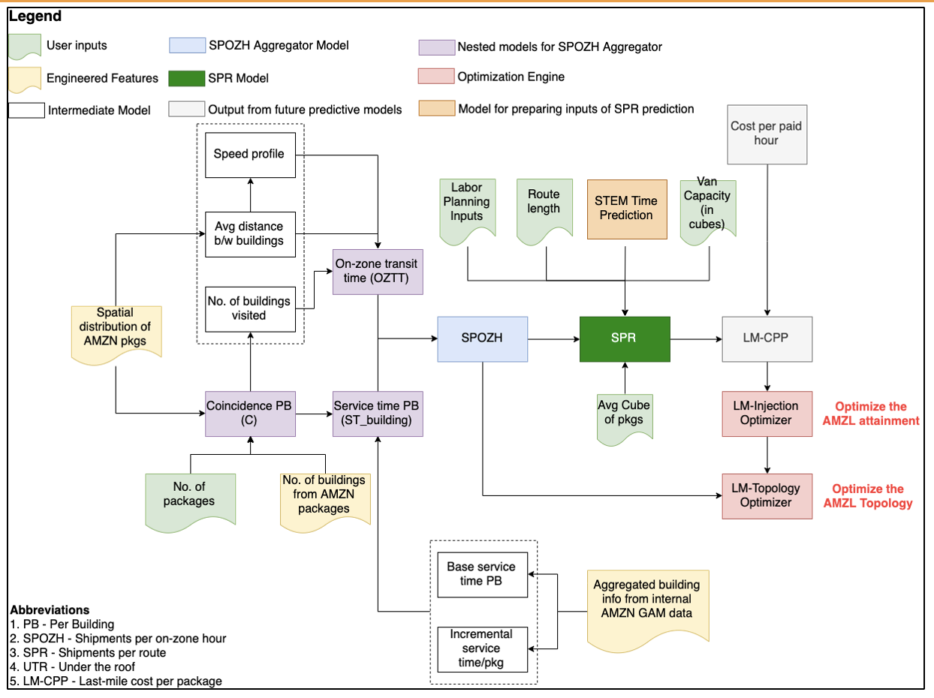
Deep Dive on Last-mile ML
Last-Mile @ Amazon is $$
Notes:
Now, that was a perspective when I look at breadth of science applications in eCommerce, but here is a flowchart of the system I designed and developed to just predict the last mile efficiency of deliver performed by Amazon, which serves as a critical input to $2B+ decisions at Amazon such as labor hiring for last-mile deliveries, buying fleet of diff sizes, last-mile warehouse topology optimization, etc. This model I solely developed comprised 5 different ML and stats models working in conjunction, and was among the top 10 research and development (out of 500+) projects in 2020 within the Consumer Org (aka the supply chain org). But anyway, this is just to show that when you’re working at big companies, you get to spend 2 years on developing projects just for one niche domain within operations!

Slide 14
Tips to Get In: From the Other Side
Functional & Behavioral
Science Breadth
Science Depth
Science Application to Business
Coding/Scripting
Know Your Company
Notes:
Now, we’ve learnt that working as a scientist in eCommerce industry is so cool! Now, what are the factors I have seen leaders look for when they’re looking for best candidates for roles in the eCommerce?
First – science breadth. Depending on the domain of eCommerce you’re interviewing, science breadth could mean a mix of stats/optimization/ml/simulation and sometimes NLP and computer vision too! Having a decent high level knowledge in cross cutting science concepts that apply across the relevant domains is key. For example, knowing about concepts such as p-value, probability concepts, confusion matrices, regression, linear programming, etc is good because that just shows you can function as a generalist and develop in-depth if expertise when needed.
Second – science depth, this would basically mean that you understand in-depth concepts related to a field or two of your interest!
Third – science application to business. This is the place where I have seen folks perform not so well in general. In the 100+ interviews I have done for Amazon, a lot of people just jump into solutions for the problems asked, instead of asking for clarifying questions, which could help make the problem being discussed much simpler than it sounds!
Fourth – coding/scripting: I think there’s no shortcut to this. Depending on the type of science role you’re interviewing for (like, MLE/Applied Science or Data Science), the level of coding skills needed might vary. But in general, functional programming in python and SQL are a must!
Lastly, know about the company you’re applying to! Like for Amazon, we’re super big on leadership principles. Also remember, knowing that the company is a good fit for you is as important as knowing if you’re a good fit for it or not!

Slide 15
Tips to Succeed
Understand & Simplify
Solve the right problem: Want <> Need
Find your niche, and play to your strengths
Balance Speed with Quality
Build Systems that are Upstream/Downstream Aware
Notes:
Finally, tips to succeed in science roles @ ecommerce. First, know your customer – who are you solving this problem for, and what is the problem they need you to solve? A lot of times, what your PM would want you to solve is very different from what they need! Clarify the problem, ask a lot of questions to learn about their perspective of the problem. There’s almost always a catch here, ALMOST ALWAYS!
Second, find your niche on the science domain, problem domain, etc and play to your strengths in that! You would not believe how often I have seen very average generalist get success in eCommerce just because their strengths outweigh their averages by so much!
Third, learn to balance speed with quality. Science is such a wide domain, like for example, if someone comes to me with a forecasting problem, there are atleast a 100 ways I can solve that. But will I apply all of them? No! I’d spend some time in rationalizing or ruling out most of the approaches, and then try a handful that fit the context of the problem well! This allows me to develop a solution fast enough, while at the same time ensuring quality of solution. This comes with some experience, but if you pay conscious attention to it, it’ll come to you fast.
Fourth, always think ahead – don’t develop a solution that becomes redundant soon! Build solutions that are upstream and downstream aware, this makes them more robust to process changes.

Slide 16
Questions?

