Slide 1
INFORMS Insights: Top Ten Lessons for a Productive and Fulfilling Career in Analytics
Douglas Trent
Sr. Data Scientist
NASA Langley Research Center
May 18, 2023
OCIO Data Science Services

Slide 2
Lesson 10: Learn How to Learn from Your Mistakes
Good judgement <- Experience <- Bad judgement
Failure is a powerful teacher
Learning from failure requires humility
Hidden beauty of a mistake = Lesson inside
Relish the customer objection
Acknowledge your mistakes, to let others know you won’t repeat them
To err is human; To really screw up requires an AI
Apology =
Acknowledge the specific
+ How impacted the other person and their feelings
+ What you will change
+ Ask forgiveness
(Formula)

Slide 3
Lesson 9: Combine Synergistic Things
Learn from Your Mistakes
Elec Engr + Comp Sci = Solve any problem
Dev’t + Marketing/Sales = Customer Understanding
R&D + MBA = Run the business
Mix Line and Staff Positions
Synergy is everywhere, waiting to be tapped
Credit for Synergy flows to the Deal-Maker
(Formula)
1 + 1 > 2

Slide 4
Lesson 8: Be a Generalist AND a Specialist
Learn from Your Mistakes
Combine Synergistic Things
Reject false dichotomies
Generalist risk = Interchangeable commodity
Specialist risk = Less career mobility
Combine to diversify the risk
Obtain just-in time expertise
Skate to where the puck is going to be. (Gretzky)
Why choose? Do both! (me)
Option A ∩ Option B > 0

Slide 5
Lesson 7: Step Outside Your Role (and Your Comfort Zone)
Obtain a mix of skills AND job experiences
Be visible to other parts of the enterprise
Seize initiative at every opportunity
Avoid low-initiative assignments
Lean into the next higher initiative level
Learn from Your Mistakes
Combine Synergistic Things
Be a Generalist AND a Specialist
It may be better to ask for forgiveness than for permission. (Adm. Grace Hopper)
When is the last time you did something for the first time?
You miss 100% of the shots you don’t take. (Gretzky)
Degrees of Initiative
Low
High
1. Wait until told
2. Ask what to do
3. Recommend, then take action on the decision
4. Act independently, but advise at once
5. Act on your own, then routinely report

Slide 6
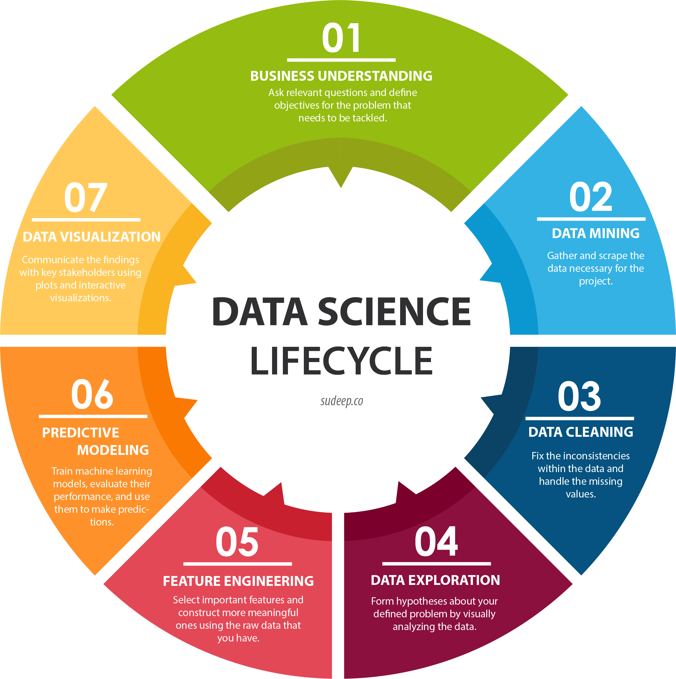
Lesson 6: Take this Job and Expand It
Learn from Your Mistakes
Combine Synergistic Things
Be a Generalist AND a Specialist
Step Outside your Role
Where are you linked in the Value Chain?
Advocate for your internal suppliers/customers
But don’t do their jobs!
Data Science
Life Cycle

Slide 7
Lesson 5: Leadership = Vision + Motivation
Learn from Your Mistakes
Combine Synergistic Things
Be a Generalist AND a Specialist
Step Outside your Role
Take this Job and Expand It
Leadership begins with a Vision
Capture your Vision with sensory words
Put your Vision on display as a beacon
Lead by Example
Catch people doing things right
Praise in public, criticize in private
Nothing to it, but to do it.
Feedback =
Identify the specific
+ How it impacted you and your feelings
+ What you want to change
+ Ask for agreement in an uplifting way

Slide 8
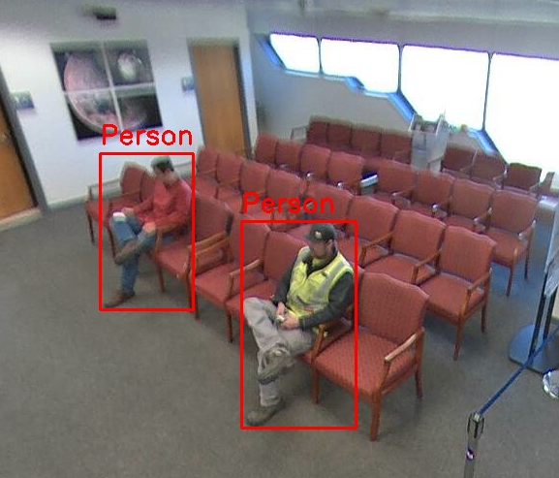
Lesson 4: Communicate, Communicate, Communicate
Learn from Your Mistakes
Combine Synergistic Things
Be a Generalist AND a Specialist
Step Outside your Role
Take this Job and Expand It
Leadership = Vision + Motivation
Translate the Vision into compelling motivation
Great speakers are made, not born
Techniques: Eye contact, vocal inflection, energy, the power of three … etc. etc.
Master the elevator speech
When you get the order, stop talking!
Communication works for those who work at it.
Elevator Speech =
Needs + Features + Advantages + Response (NFAR)

Slide 9
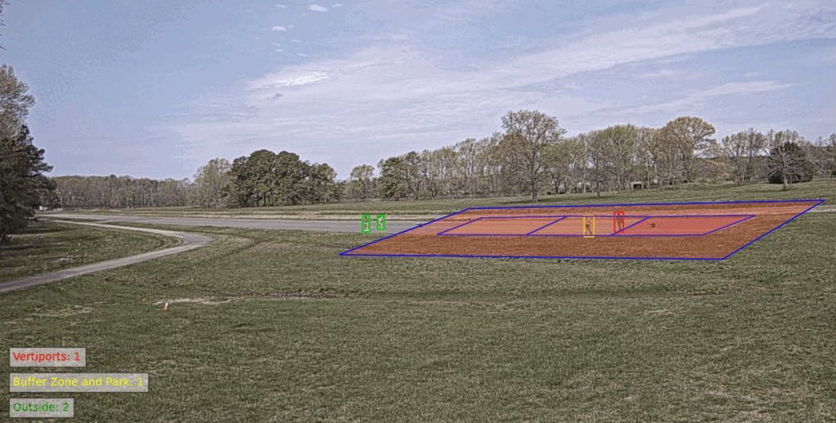
Lesson 3: Create the Differentiator – Go the Extra Mile
Learn from Your Mistakes
Combine Synergistic Things
Be a Generalist AND a Specialist
Step Outside your Role
Take this Job and Expand It
Leadership = Vision + Motivation
Communicate!
Be a little different to stand out from the crowd
WAHLDO = Wide-Area Hazard Locator for Drone Overflight
NASA count-down from Ten
The raffle ticket secret (shhh!)
Differentiation happens at the margins
Deliver the extra 2% to distinguish yourself
WAHLDO on Langley Flight Range
1.02x >> x

Slide 10
Lesson 2: Persistence Pays
Learn from Your Mistakes
Combine Synergistic Things
Be a Generalist AND a Specialist
Step Outside your Role
Take this Job and Expand It
Leadership = Vision + Motivation
Communicate!
Create the Differentiator
Initiative can be difficult in corporate beauracracies
Simple secret: Never give up! (Back up and go around)
Socialize your proposal in advance
Get buy-in by having others think of your idea
Newton’s Second Law of motion as a model
Outlast the naysayers
Persistence as a questioning technique
Every battle is won before it’s ever fought. (Sun Tzu)
Force = Mass * Acceleration

Slide 11
Lesson 1: Failure is not an Option; It’s a Requirement!
Learn from Your Mistakes
Combine Synergistic Things
Be a Generalist AND a Specialist
Step Outside your Role
Take this Job and Expand It
Leadership = Vision + Motivation
Communicate!
Create the Differentiator
Persistence Pays
Proactively seek to fail, early and often
Failure economics – pay a little now, or a lot more later
Test to failure
All products/programs have defects (model drift)
Fix one thing but don’t break another (regression test)
But wait, there’s more!
Failure is your friend if you confront it early;
Your worst enemy if you meet it later.
Cost of failure = e^{t}

Slide 12
Lesson 0: Your Career is a Journey, not a Destination
Learn from Your Mistakes
Combine Synergistic Things
Be a Generalist AND a Specialist
Step Outside your Role
Take this Job and Expand It
Leadership = Vision + Motivation
Communicate!
Create the Differentiator
Persistence Pays
Failure is a Requirement
Don’t let destination obsession obscure the journey
Team travel is a journey too
Smell the roses and enjoy the ride!
If you can’t fix it, feature it.
If you can’t get out of it, get into it.
The quality of life is in proportion, always, to the capacity for delight. The capacity for delight is the gift of paying attention. ― Julia Cameron
Your Quality of life
~ Your Capacity for delight
~ Your Power of observation and ability to pay attention

Slide 13
Learn from Your Mistakes
Combine Synergistic Things
Be a Generalist AND a Specialist
Step Outside your Role
Take this Job and Expand It
Leadership = Vision + Motivation
Communicate!
Create the Differentiator
Persistence Pays
Failure is a Requirement
Your Career is a Journey
Questions and Answers

